Slide 1
Sales Engineer Training: Chapter 3 Enterprise Infrastructure and Application Technologies
Notes:
Welcome to Sales Engineer Certification training, Chapter 3: Enterprise Infrastructure and Application Technologies. We will be discussing the common modern day distributed application infrastructures and the technologies behind them. Additionally, we will differentiate the technologies that are Supported by AppDynamics APM Solution, as well as technologies that are not Supported.

Slide 2




Agenda:
Distributed Application Architectures: Java, .NET, PHP
AppDynamics Instrumentation-How Does it Work?
APM Goals: Root Cause Identification & Code-level Visibility
Where We Play and Do Not Play - Supported Environments
Notes:
Our agenda will include an overview modern distributed applications and their architectures. We will also discuss how AppDynamics can give us code-level visibility of issues in your application as well as a business flavor as opposed to just being performance related. This is often of keen interest to our customers where users are in the line of business and would like to have some visibility into business operations. We’ll then wrap up with some exercises.

Slide 3

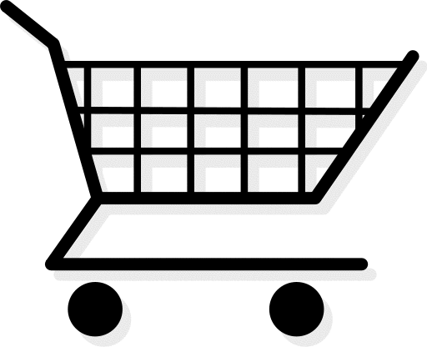
Distributed Application Architectures
Release 1.1
Release 1.2
Release 1.23
Release 1.5
.NET
Amazon EC2
Windows Azure
Tomcat
CLOUD
Release 2.4
Release 2.5
Release 2.6
Release 3.0
Tomcat
Mule, Tibco, WebMethods
ESB
Tomcat
VMWare
Login
Search
Add to Cart
Checkout
WEB 2.0
Memcached
Oracle
Weblogic
Release 4.4
Release 4.5
Release 4.6
Release 5.0
Browser Logic
AJAX
Web Frameworks
Release 1.4
Release 1.5
Release 1.6
Release 2.0
Coherence
SOA
Hadoop
Cassandra
MongoDB
.NET
MQ
JBoss
AGILE
Release 3.4
Release 3.5
Release 3.6
Release 4.0
Release 1.4
Release 1.5
Release 1.6
Release 2.0
BIG DATA
SQL Server
ATG, Vignette,
Sharepoint
Notes:
Over time, modern application architectures and operating environments have grown in complexity. From the introduction of SOA distributed environments (Mule, Tibco, WebMethods ESBs).
To the additions of Cloud (Amazon EC2 and Windows Azure becoming low-cost alternative in apps) and Big Data (Hadoop, Casandra, MongoDB). And even dynamic data caching with Coherence and Memecached… Also Web 2.0, more code being introduced into the Browser-level and freuqent Agile Development-shorter release cycles, make monitoring these distributed applications more difficult.

Slide 4
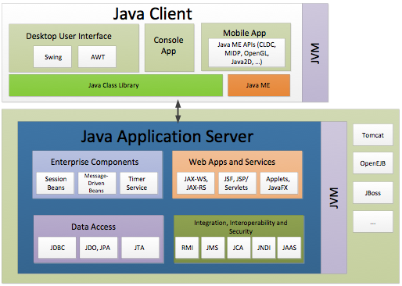
J2EE/Java Application Architecture
Front-End Clients
Desktop UI: Swing, AWT
Console Web App: Applets, Web Services
Mobile App: Java ME APIs, MDP, JavaZD
Implements Java Class Library
Web Apps/Services:
Frameworks: JAX-WS, JAX-RS, JSF, JSP, Servlets, Web Services
Enterprise: EJBs (Session and Message driven)
Integration Services: RMI, JMS, JCA, JNDI, JAAS
Data Access: JDBC, JDO/JPA, JTA
Runs in JVM (Tomcat, JBoss, WebLogic, etc.)
Notes:
This is an example of a Java/J2EE Application Architecture with a few front-end clients, one Desktop UI using Java Swing or Absract Window Toolkit, a Console App, perhaps accessed by the web browser and a Mobile App using Java ME APIs, MDP, JavaZD
The Enterprise Components consist of Session and Message-Driven EJBs and a Timer Service
There is a Web App/Services Layer with several frameworks including JAX-WS, JAX-RS, Java Service Faces, Java Service Pages, Servlets and so on…
Additional Integration, Interoperability and Security can be implemented with RMI, JMS, JCA, JNDI, JAAS
And, the Data Layer can be accessed using JDBC, JDO/JPA or JTA calls
All run in the Java Virtual Machine or JVM, which could be Tomcat, JBoss, WebLogic, WebSphere, and OpenEJB for Enterprise

Slide 5
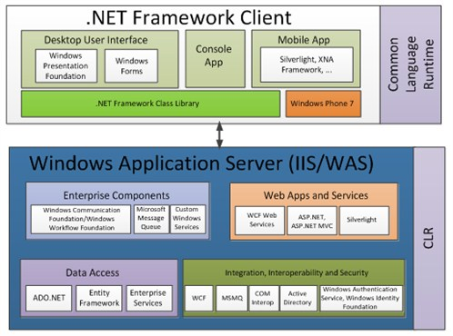
.NET Application Architecture
Front-End Clients
Desktop UI in WPF, Windows Forms
Console App using Web browser
Mobile App Clients on Silverlight, XNA Framework
Implements .NET Framework Class Library, runs in Common Language Runtime (CLR)
Internet Information Services (IIS)/Windows Application Server (WAS):
Enterprise Component Frameworks: WCF, WF, MS Message Queue, Windows Services
Web Apps/Services: WCF Web Services, ASP.NET, MVC, Silverlight
Data Access: ADO.NET, Entity Framework
Runs in Common Language Runtime (CLR)
Notes:
Here is an example of a .NET Application
Front-End Clients
Desktop UI in WPF, Windows Forms
Console App using Web browser
Mobile App Clients on Silverlight, XNA Framework
Implements .NET Framework Class Library, runs in Common Language Runtime (CLR)
Internet Information Services (IIS)/Windows Application Server (WAS):
Enterprise Component Frameworks: WCF, WF, MS Message Queue, Windows Services
Web Apps/Services: WCF Web Services, ASP.NET, MVC, Silverlight
Data Access: ADO.NET, Entity Framework
Runs in Common Language Runtime (CLR)

Slide 6
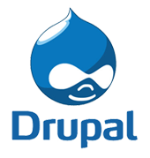
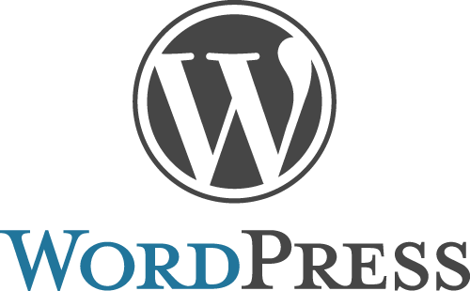
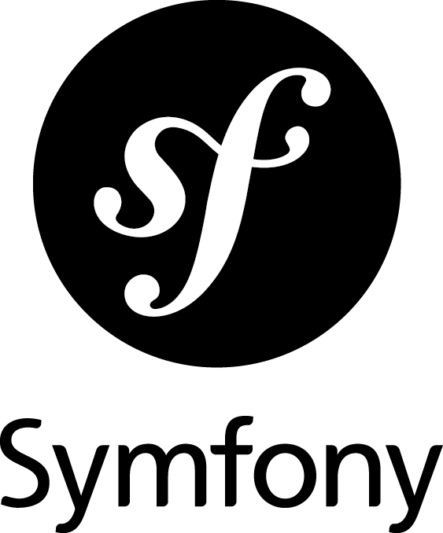
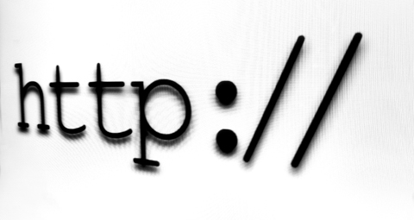
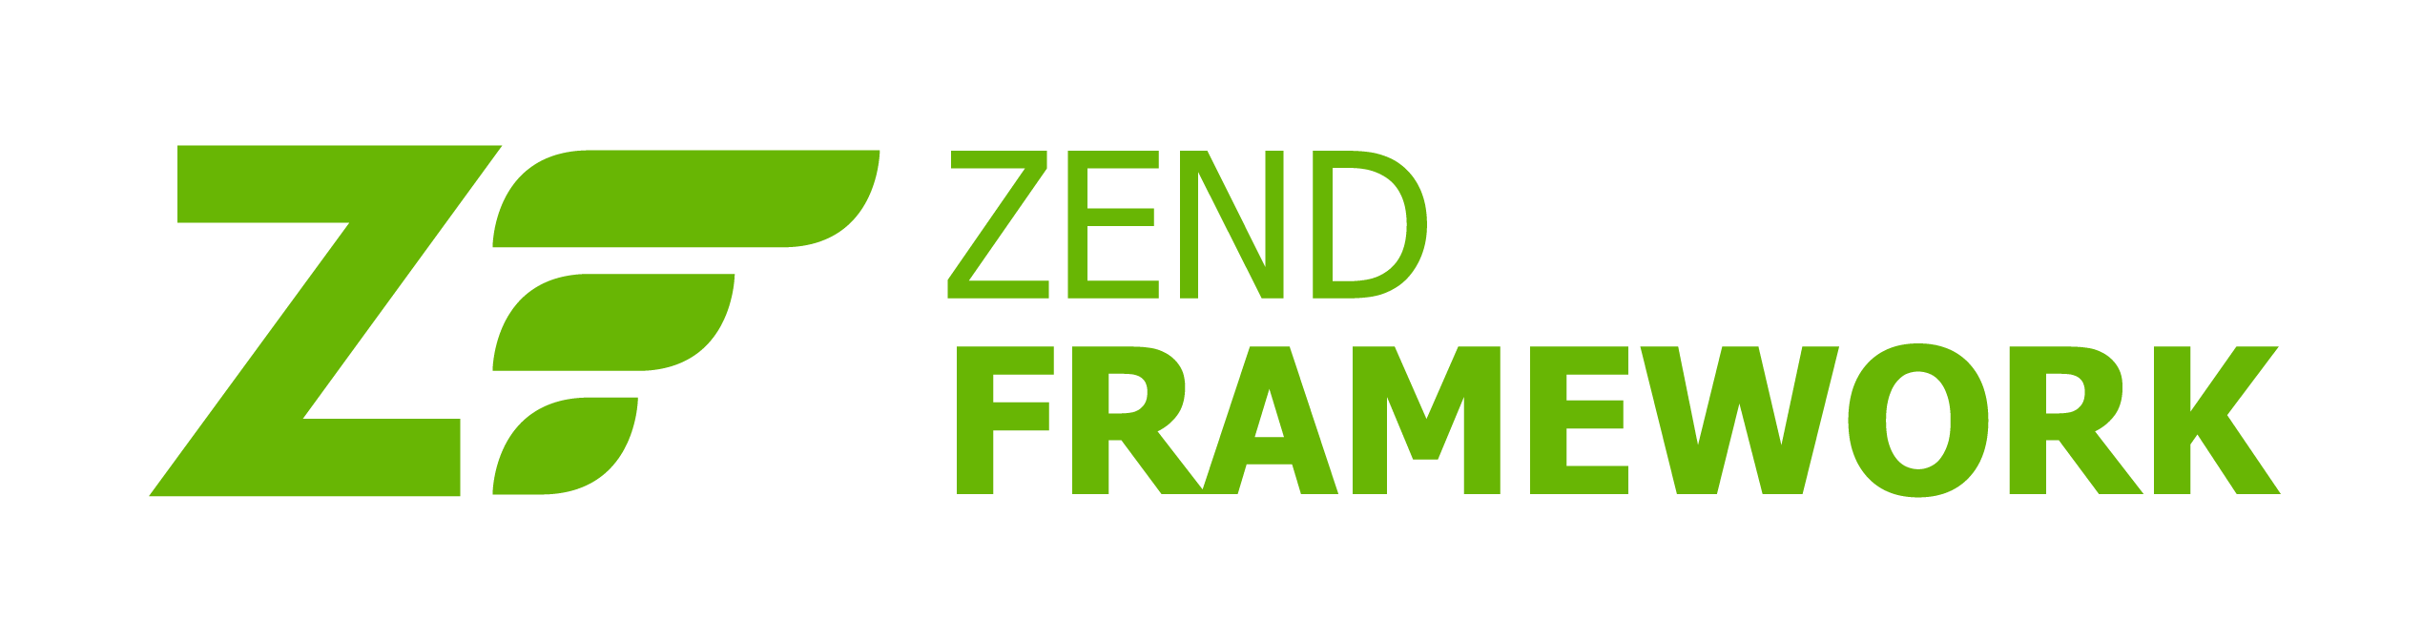
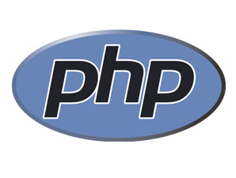
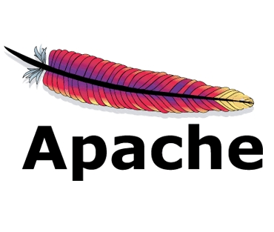
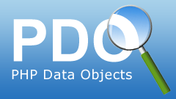
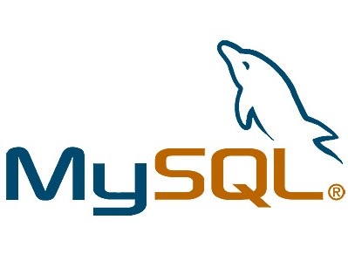
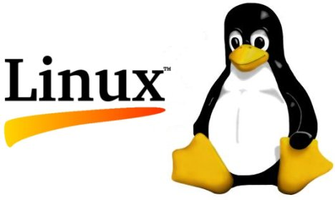
PHP Application Architecture
PHP can be both Procedural or Object-Oriented
Interpreted to ByteCode and then run by the Zend engine
Lamp Stack Configuration
Linux OS
Apache Web Server
MySQL Database
PHP language
Frameworks
Drupal, WordPress, Zend, Symfony (MVC), and HTTP Web Apps
Websites
Web apps (MVC)
Web apps (HTTP)
Language
Web Server
DB
Operating System
Notes:
PHP can be both Procedural or Object-Oriented
Interpreted to ByteCode and then run by the Zend engine
Lamp Stack Configuration
Linux OS
Apache Web Server
MySQL Database
PHP language
Frameworks
Drupal, WordPress, Zend, Symfony (MVC), and HTTP Web Apps

Slide 7
AppDynamics Instrumentation-How Does It Work?
AppDynamics Agent Technology uses ByteCode (BCI) instrumentation
Bytecode instrumentation (or Java hooks) that retrieve data from the nodes that are running J2EE/.NET applications. This is done by utilizing the class loading mechanism of the interpreter (JVM for J2EE or CLR for .NET) to intercept specific classes or methods, called within the application
JDK 1.5/.NET 2.0 versions support code execution by the class loader itself, thus allowing BCI by specific class/method (not supported prior to JDK 1.5/.NET 2.0)
BCI is what allows AppDynamics the code-level, specific line of code visibility that is the cause of the problem
PHP BCI is a little different
Uses a PHP Extension Module that collects BCI from PHP code, which talks to a Java Proxy Daemon that sends the agent data
Notes:
AppDynamics uses ByteCode (BCI) instrumentation (or Java hooks) that will retrieve data from the nodes that are running J2EE/.NET applications. This is done by utilizing the class loading mechanism of the interpreter (JVM for J2EE or CLR for .NET) to intercept specific classes or methods, called within the application
BCI is what allows the code-level, specific line of code visibility that is the cause of the problem
JDK 1.5/.NET 2.0 versions support code execution by the class loader itself, thus allowing BCI by specific class/method (not supported prior to JDK 1.5/.NET 2.0)
PHP is instrumented with BCI, but there is a PHP extension that collects the

Slide 8
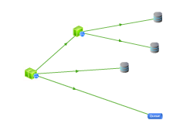
Business Transaction Auto-Discovery
Application Code
Application Server Stack
Application Code
Application Server Stack
JVM / .NET CLR
Tag and Follow
Application Code
JVM / .NET CLR
Application Server Stack
Automatic Byte Code Instrumentation
Business Transaction Auto-Discovery
JVM / .NET CLR
1
Byte Code Instrumentation (BCI) automatically injected into application with no code changes
2
Requests are automatically identified by framework as Business Transactions
3
“Tag and Follow” the Business Transactions across tiers via protocol header decoration
4
Auto-Discovery identifies the tiers and services participating in the end-to-end transaction flow
Notes:
The Byte Code Instrumentation will be automatically injected into the application when the instrumented methods are called. These requests are then automatically identified as Business Transactions by framework and these transactions are correlated across tiers using a “tag and follow” method of decorating the protocol header. The Application Topology view is then mapped out Automatically by Tiers and services from the Business Transaction entry point in the application, correlating across Tiers/Services to the backend service or where they exit the application. This gives a completely end-to-end view of your application, as well as the business context that maps back and is relevant to the end-user.

Slide 9

APM Goal: Root Cause Identification
Health Rule or Policy Event
Triggers Diagnostic
Data Collection
Collects Transaction Snapshots
Complete distributed Call Graphs (method call stacks)
Logged/Thrown Exception stack traces
All SQL queries, most expensive identified
JVM/Hardware correlation
Stalled Thread Dumps – for stalled requests
HTTP Data – parameters, cookies, session keys, etc
Method Invocation Data (Parameter orderID/Values)
Transaction Snapshot
Notes:
In order to automatically detect and identify issues, Health Rules or Policies are set and when the threshold is crossed (i.e. CPU 75%), an event occurs and triggers a diagnostic data collection, which will collect the root-cause artifacts that we call “Transaction Snapshots”. These Transaction Snapshots include the complete and correlated Call Graphs/Method call stacks, any logged Errors or thrown exception stack traces, SQL queries with most expensive identified, JVM/Hardware correlation, Thread Dumps of stalled requests, additional HTTP User Data such as cookies, session keys, and Method Invocation Data collectors for parameter orderIDs and values. Transaction Snapshot diagnostic data collection is where you can drill down to root cause and down to the actual code-level identified of the problem.

Slide 10
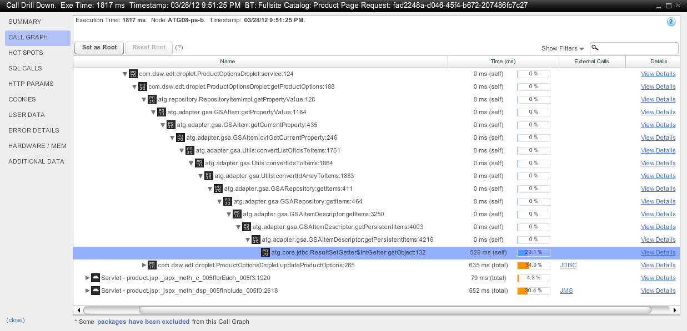
APM Goal: Code-Level Visibility
Shows the complete code execution of an individual Business Transaction with timing for ALL classes/methods in the call stack with code-level granularity
Notes:
The default view when drilling down into the Transaction Snapshot is the Call Graph… Notice the Call Graph view shows the entire method call stack and this is where it identifies the EXACT line of code where the problem(s) exist for each method call as well as the transaction timing for all classes/methods.

Slide 11
Where We Play and Where We Don’t Play
Agents
JDK 1.5+, .NET v2.x+
Controller
Linux: RHEL, CentOS, Fedora, Ubuntu, SUSE
Windows: Server 2003, 2008, 2012, Windows 8
Containers
WAS, WebLogic, Tomcat, JBoss, Jetty, etc.
Automatic Discovery
Web Frameworks, messaging, SOA, RMI, JDBC, Caches, Big Data/NoSQL
COBOL, C++, Legacy Compiled Code Apps, Mainframes, Oracle Applications/Siebel/JDEdwards, SAP, not supported
Partial Support: Fat Client Apps on Desktop, Peoplesoft (Tuxedo)
Notes:
Agents
JDK 1.5+, .NET v2.x+
Controller
RHEL, CentOS, Fedora, Ubuntu, SUSE, Windows Server 2003, 2008
Containers
WAS, WLS, Tomcat, JBoss, Jetty, OSGi,
Automatic Discovery
Web Frameworks, messaging, SOA, RMI, JDBC, Caches, Big Data/NoSQL (MongoDB, Casandra)
COBOL, C++, Legacy Compiled Code Apps, Mainframes, Oracle Applications/Siebel/JDEdwards, SAP, not supported
Partial Support: Fat Client Apps on Desktop, Peoplesoft (Tuxedo)

Slide 12
Agent Support Matrix*
Run-Time Platforms | Application Servers | Messaging | Frameworks | Databases/Backends
Java 1.5 – 1.7 Microsoft .Net v 2.0– 4.5 C++ (via code wrapper) *Not all inclusive | ColdFusion 8 & 9 GlassFish 2 & 3 JBoss 4 - 7 Jetty 6 & 7 Oracle 10g (.2/3) OC4J (Oracle Application Server) OSGi Infrastructure (Felix, Equinox, Apache Sling) Resin Solr Tomcat 5 - 7 WebLogic 9 & 10 Webmethods WebSphere 6 & 7 Microsoft IIS 6- 7.5 COM+ services Windows Service Console Applications | Active MQ 5.x Fiorano MQ IBM MQ Series 6.x, 7.x IBM WAS Embedded JMS JBoss MQ Oracle AQ-JMS Open MQ Progress Sonic MQ Rabbit MQ Tibco RV JMS Messaging WCF .NET Remoting Tibco EMS MQ MSMQ | Applets AWT/Swing/RCP BlazeDS EJB 2 & 3 Hibernate Wicket JSF Oracle Coherence Spring Beans 2 & 3 Servlets 2.x Struts Action 1 & 2 Tapestry Axis 1.x, 2.x CXF 2.1 Glassfish Metro JAX WS JBoss Native Stack OC4J Weblogic JAX Webmethods Glue Websphere JAX-WS Xfire Apache ActiveMQ NMS framework ASP.NET ASP.NET MVC 2 & 3 ADO.NET | Oracle 8i Oracle 9i Oracle 10g Oracle 11g IBM DB2 9.x Informix MS SQL Server 2005 MS SQL Server 2008 Postgres 8 & 9 MySQL 5 PointBase Derby Sybase Cassandra MongoDB Javamail SAP JCO LDAP Coherence Ehcache JBoss Tree Cache / Tree Cache AOP MemCache
Notes:
As you can see from this Agent Support Matrix… the AppServerAgent Support is quite extensive for both Java and .NET. Several common AppServers are Tomcat, Jboss, WebLogic and WebSphere, Frameworks: Spring, Struts, JSF, Servlets, Applets

Slide 13
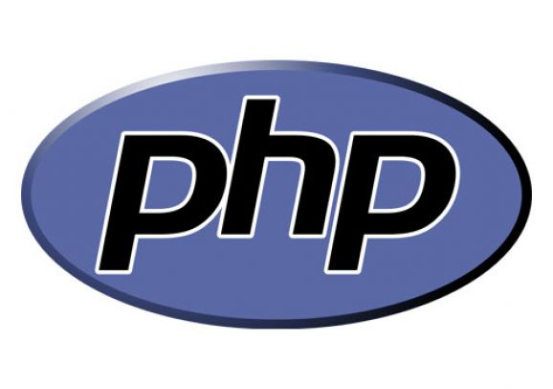
PHP Support Matrix
Notes:
Initial PHP Support is limited to the LAMP Stack, PHP versions 5.3, 5.4, on Linux with Drupal 7, WordPress 3, Zend 1, Symfony 1 & 2 and HTTP Support. Backends MySQL, PDO, and Cache Monitoring with Alternative PHP Cache and memchached supported as well.

Slide 14
Summary
Overview of Distributed Application Architectures: Java, .NET, PHP
How AppDynamics Instumentation (BCI) and Agent Technology Works
Enables Business Transaction Auto-Discovery, giving End-User Business Context
Reviewed Common APM Goals
Root Cause Identification
Code-level Visibility of Application
AppDynamics Supported Environments
Notes:
In Summary… we’ve seen an Overview of Distributed Application Architectures: Java, .NET, PHP
How AppDynamics Instumentation (BCI) and Agent Technology Works
Enables Business Transaction Auto-Discovery, giving End-User Business Context
Reviewed Common APM Goals
Root Cause Identification
Code-level Visibility of Application
AppDynamics Supported Environments

